Slide 1
MODEL WTO 2018
21st Edition
6th - 13th APRIL

Slide 2
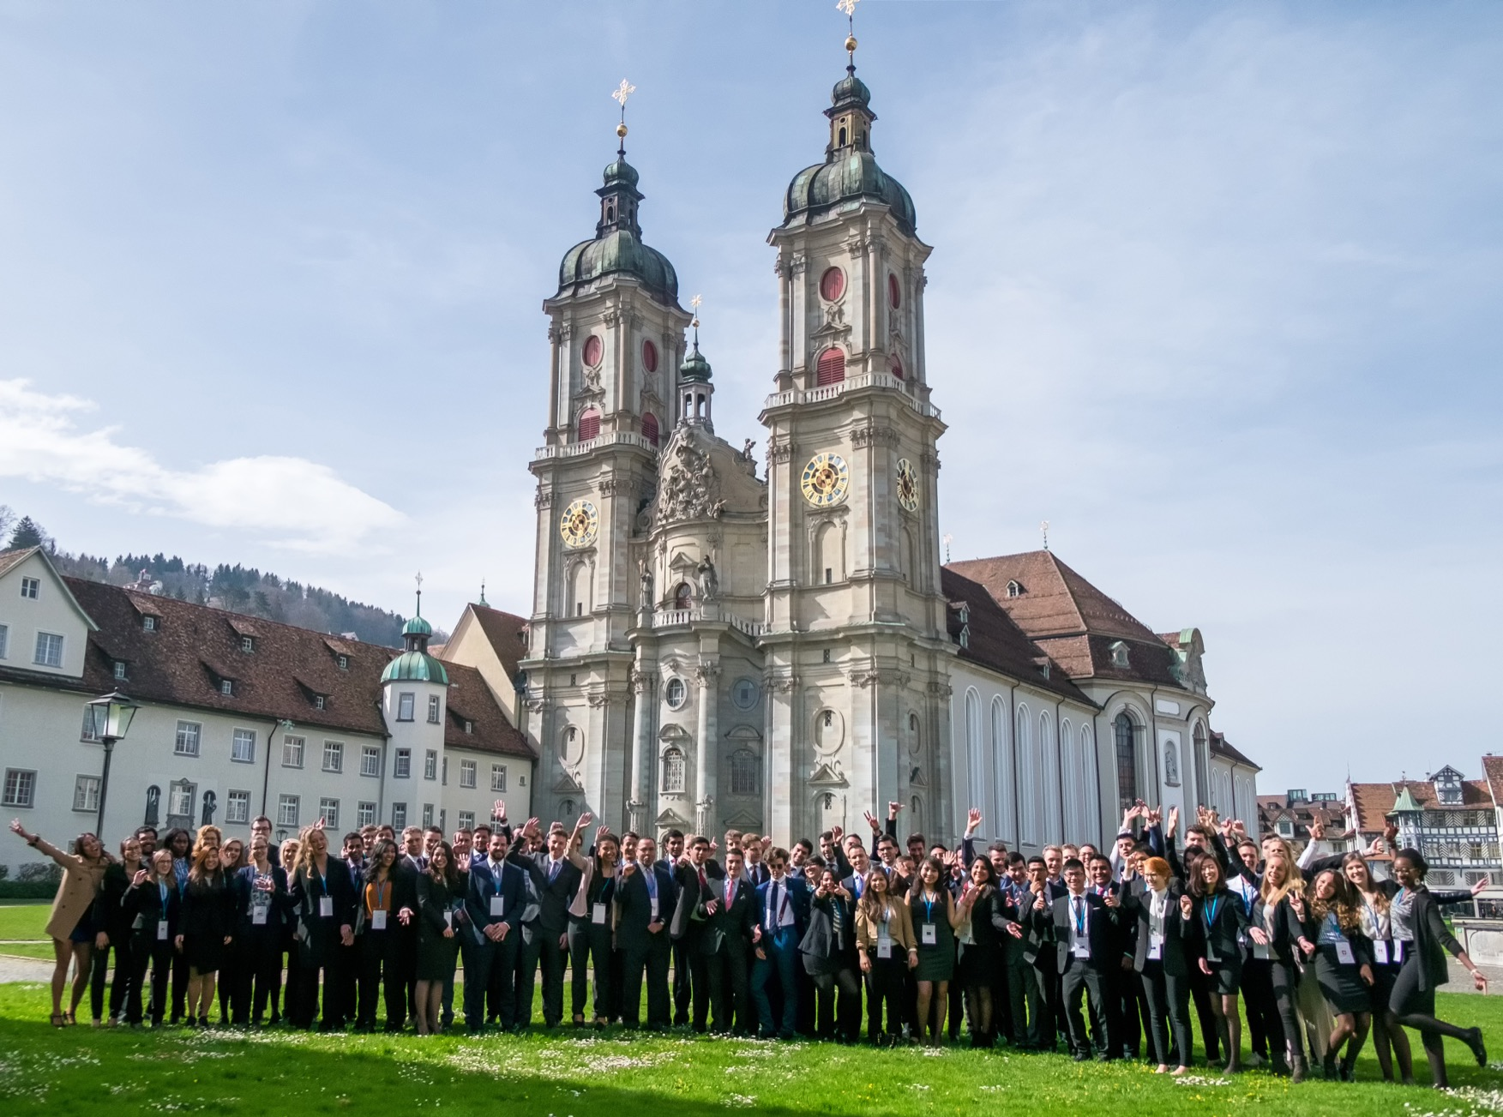
The Model World Trade Organization
www.model-wto.org
info@model-wto.org

Slide 3
01|
Model WTO 2018
Brochure
The objective of Model WTO
... provide a unique opportunity for future decision-makers to face important global issues within the simulation framework of the WTO ministerial negotiations
…to sensitize our student audience to the current issues of international trade as well as to enable the participants to have a unique insight into the procedure for adopting trade resolutions
... seek the exchange of knowledge,
the meeting of international students from different backgrounds, and the active participation of young people in today's society

Slide 4
02|
Model WTO 2018
Brochure
Key Facts
72 international participants
University of St. Gallen, Swizerland & WTO Headquarters Geneva
CHF 370
incl. board and lodging
Various social events
during the entire event

Slide 5
04|
Model WTO 2018
Brochure
03|
Model WTO 2018
Brochure
Week Outline 6TH-13TH April
Week Outline 6th-13th April
Friday
Saturday
Sunday
Tuesday
Wednesday
Thursday
Friday
-
Arrival in St. Gallen
Team Building Agenda
Negotiations
(6 rounds / 2 per day)
Transfer to Geneva
Ambassador Meetings
Closing Ceremony at WTO
Departure Day
Friday
Departure day

Slide 6
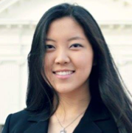
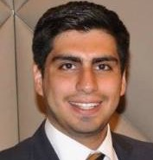
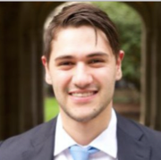
04|
Model WTO 2018
Brochure
Impressions from Previous Participants
“Nothing gives you a taste of real diplomacy quite like sitting in a negotiation room with twelve other delegates, hammering out a consensus document for hours.”
Yelong Zhu
Harvard University, USA
“A week that definitely adds to your personal, academic, and professional spheres through a superb simulation.”
César Andrés Peniche Luna
Universidad Nacional Autónoma
de México, Mexico
“The negotiation simulations were a unique experience to discuss and learn from exceptionally talented people from across the world.”
Andrew Lunardi
Oxford University, UK
Notes:
Same remark for the color of the pictures

Slide 7

05|
Model WTO 2018
Brochure
Application Process
CV and Motivation Letter to applications@model-wto.org
Deadline: February 18th, 2018
1st Elimination Round
2-page essay to applications@model-wto.org
Deadline: February 25th, 2018
2nd Elimination Round
Confirmation of participation
March 4th, 2018
For further information please visit www.model-wto.org/participants

Slide 8





06|
Model WTO 2018
Brochure
Our Partners

Slide 9
See You at
Model WTO 2018!

